Slide 1
IT2060/IE2061
Operating Systems and System Administration
Lecture 03
Introduction to Processes
U. U. Samantha Rajapaksha
M.Sc.in IT, B.Sc.(Engineering) University of Moratuwa
Senior Lecturer SLIIT
Samantha.r@slit.lk

Slide 2
Chapter 3: Processes
Process Concept
Process Scheduling
Operations on Processes
Inter process Communication
Examples of IPC Systems
Communication in Client-Server Systems

Slide 3
Process Concept
Process – a program in execution.
Program is a passive entity stored on disk (executable file), process is active.
Program becomes process when executable file loaded into memory
Execution of program started via GUI mouse clicks, command line entry of its name, etc
One program can be several processes when multiple users executing the same program.

Slide 4
CPU
Memory Address | Content
0 | INS 1(Executed)
1 | INS 2(Executed)
2 | INS 3(Executed)
3 | INS 4(Executed)
4 | INS 5
5
PC=4
RAM

Slide 5
Process Concept (Cont.)
Process execution is sequential.
A process has a Program Counter.
It’s a register entry which specifies the next instruction to execute.
A process needs resources (CPU time, memory, files and I/O devices) to complete the execution successfully.

Slide 6
Process Concept (Cont.)
A process consists of multiple parts
The program code, also called text section
Current activity including program counter, processor registers
Stack containing temporary data
Function parameters, return addresses, local variables
Data section containing global variables
Heap containing memory dynamically allocated during run time

Slide 7
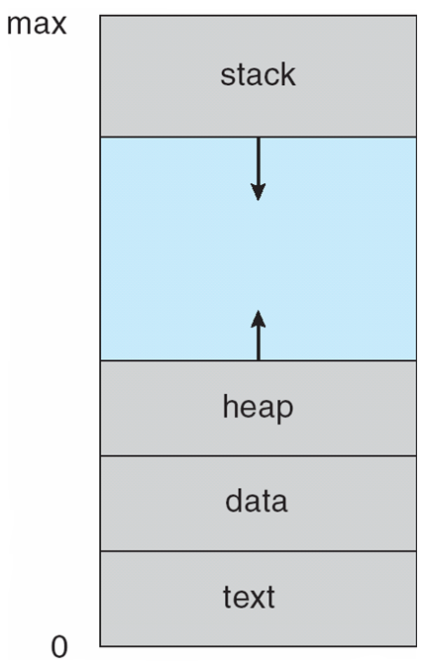
Process in Memory

Slide 8
Process State
As a process executes, it changes state
new: The process is being created
running: Instructions are being executed
waiting: The process is waiting for some event to occur
ready: The process is waiting to be assigned to a processor
terminated: The process has finished execution

Slide 9
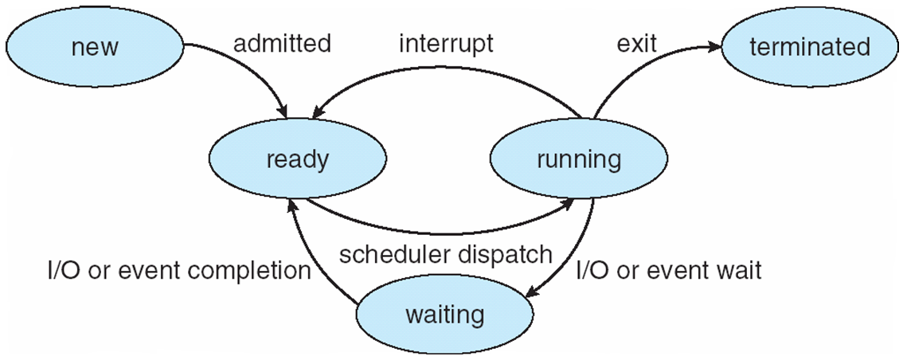
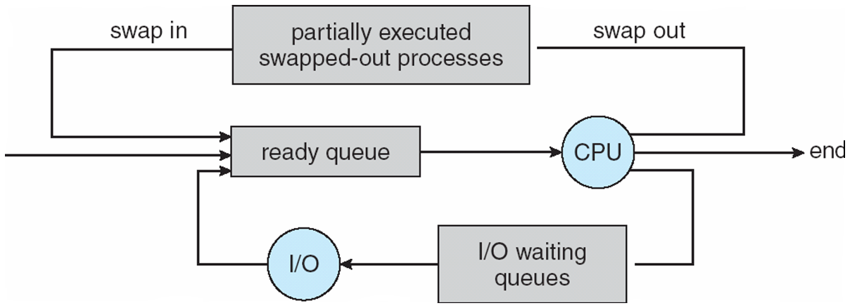
Diagram of Process State

Slide 10
P5=30ms-5ms =25ms
P1,P0,P3(50ms), P5(30ms)
P5 CPU
Interrupt
CPU
IO
CPU
Timer=5ms

Slide 11
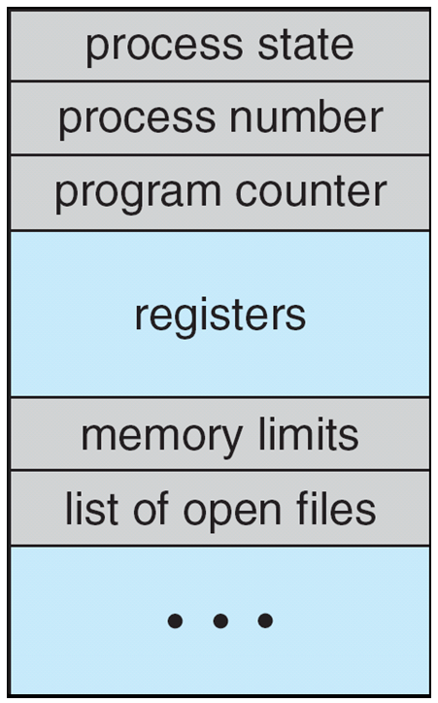
Process Control Block (PCB)
Information of each process is in PCB
(also called task control block)
Each PCB contains:
Process state – running, waiting, etc
Process number (process ID)
Program counter – location of instruction to next execute
CPU registers – contents of all process-centric registers
CPU scheduling information- priorities, scheduling queue pointers
Memory-management information – memory allocated to the process
Accounting information – CPU used, clock time elapsed since start, time limits
I/O status information – I/O devices allocated to process, list of open files

Slide 12
User Memory
Program 10
A B
Kernel Memory
PCB for process 10

Slide 13
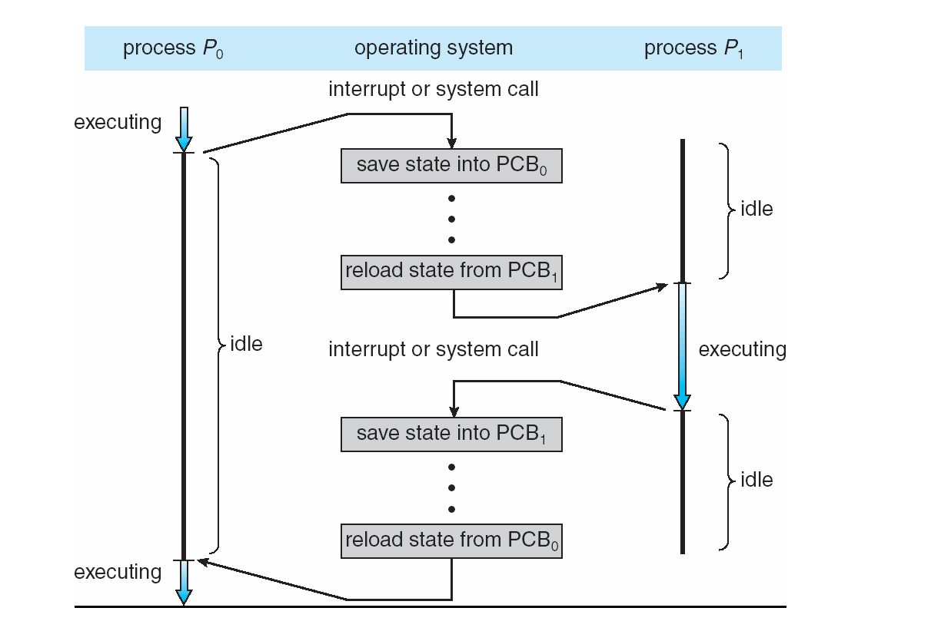
CPU Switch From Process to Process

Slide 14
Process Scheduling
Process scheduler selects among available processes for next execution on CPU
Scheduler in multiprogramming environment maximizes CPU use.
In time sharing, it quickly switches processes onto CPU
There are several scheduling queues of processes
Job queue – set of all processes in the system
Ready queue – set of all processes residing in main memory, ready and waiting to execute
Device queues – set of processes waiting for an I/O device
Processes migrate among the various queues

Slide 15
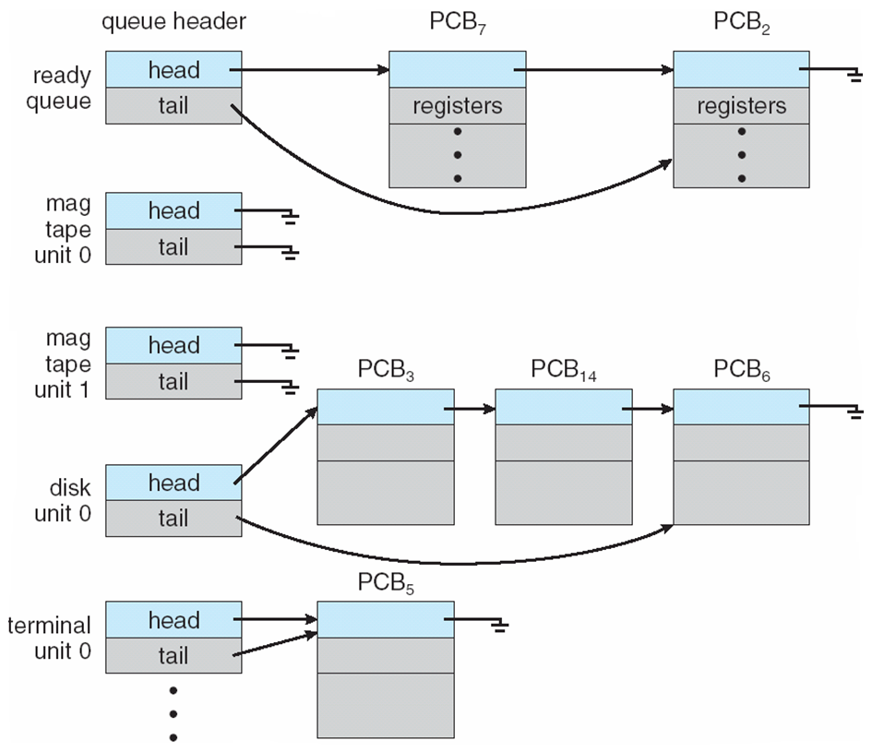
Ready Queue And Various I/O Device Queues

Slide 16
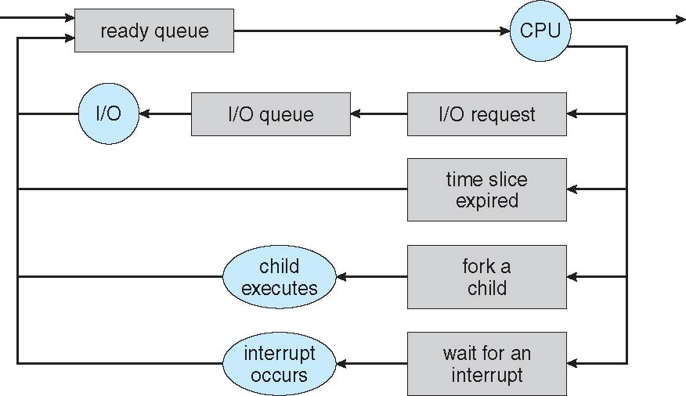
Representation of Process Scheduling
Queueing diagram represents queues, resources, flows

Slide 17
Schedulers
Short-term scheduler (or CPU scheduler) – selects which process should be executed next and allocates CPU
Sometimes the only scheduler in a system
Short-term scheduler is invoked frequently (milliseconds) ⇒ (must be fast)
Long-term scheduler (or job scheduler) – selects which processes should be brought into the ready queue
Long-term scheduler is invoked infrequently (seconds, minutes) ⇒ (may be slow)
The long-term scheduler controls the degree of multiprogramming
Processes can be described as either:
I/O-bound process – spends more time doing I/O than computations, many short CPU bursts
CPU-bound process – spends more time doing computations; few very long CPU bursts
Long-term scheduler strives for good process mix

Slide 18
Addition of Medium Term Scheduling
Medium-term scheduler can be added if degree of multiple programming needs to decrease
Remove process from memory, store on disk, bring back in from disk to continue execution: swapping

Slide 19
Context Switch
When CPU switches to another process, the system must save the state of the old process and load the saved state for the new process via a context switch
Context of a process represented in the PCB
Context-switch time is overhead; the system does no useful work while switching
The more complex the OS and the PCB ➔ the longer the context switch
Time dependent on hardware support
Some hardware provides multiple sets of registers per CPU ➔ multiple contexts loaded at once

Slide 20
Operations on Processes
System must provide mechanisms for:
process creation,
process termination,

Slide 21
Process Creation
Parent process create children processes, which, in turn create other processes, forming a tree of processes
Generally, process identified and managed via a process identifier (pid)
Resource sharing options
Parent and children share all resources
Children share subset of parent’s resources
Parent and child share no resources
Execution options
Parent and children execute concurrently
Parent waits until children terminate

Slide 22
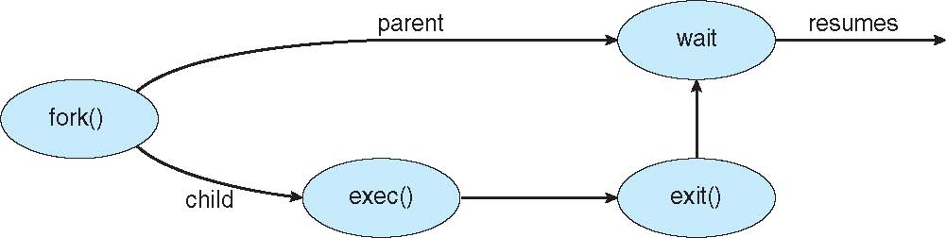
Process Creation (Cont.)
Address space
Child duplicate of parent
Child has a program loaded into it
UNIX examples
fork() system call creates new process
exec() system call used after a fork() to replace the process’ memory space with a new program

Slide 23
Print(A)
Print(B)
Child id=R=Fork()
Print(R)
Print(D)
Use Memory
parent
PC
Print(A)
Print(B)
0=R=Fork()
Print(R)
Print(D)
Parent
child
Kernel Memory
PCB
parent
PC
Child
PCB
child

Slide 24
Interprocess Communication
Processes within a system may be independent or cooperating
Cooperating process can affect or be affected by other processes, including sharing data
Cooperating processes need interprocess communication (IPC)
Two models of IPC
Shared memory
Message passing

Slide 25
Communications Models
(a) Message passing. (b) shared memory.

Slide 26
IPC through shared memory
Inter Process Communication through shared memory is a concept where two or more process can access the common memory. And communication is done via this shared memory where changes made by one process can be viewed by another process.
The problem with pipes, fifo and message queue – is that for two process to exchange information. The information has to go through the kernel

Slide 27
System call in SM
ftok(): is use to generate a unique key.
shmget(): int shmget(key_t,size_tsize,intshmflg); upon successful completion, shmget() returns an identifier for the shared memory segment.
shmat(): Before you can use a shared memory segment, you have to attach yourself
to it using shmat(). void *shmat(int shmid ,void *shmaddr ,int shmflg);
shmid is shared memory id. shmaddr specifies specific address to use but we should set
it to zero and OS will automatically choose the address.
shmdt(): When you’re done with the shared memory segment, your program should
detach itself from it using shmdt(). int shmdt(void *shmaddr);
shmctl(): when you detach from shared memory,it is not destroyed. So, to destroy
shmctl() is used. shmctl(int shmid,IPC_RMID,NULL);

Slide 28
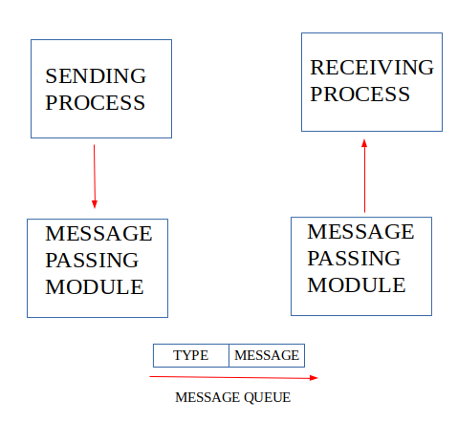
IPC using Message Queues
A message queue is a linked list of messages stored within the kernel and identified by a message queue identifier. A new queue is created or an existing queue opened by msgget().

Slide 29
System cals in MQ
ftok(): is use to generate a unique key.
msgget(): either returns the message queue identifier for a newly created message
queue or returns the identifiers for a queue which exists with the same key value.
msgsnd(): Data is placed on to a message queue by calling msgsnd().
msgrcv(): messages are retrieved from a queue.
msgctl(): It performs various operations on a queue. Generally it is use to
destroy message queue.

Slide 30
Pipes
Oldest (and perhaps simplest) form of UNIX IPC
Half duplex. The oldest mechanism for IPC in Unix is pipes.
Here's the prototype:
#include <unistd.h>
int pipe(int fildes[2]);
Pipe takes an array of two ints (two file descriptors) and, if the kernel succeeds in creating the pipe, it puts the file descriptor for the reading end of the pipe in the 0th entry
e.g. filedes[0], and it puts the file descriptor for the write end of the pipe in the 1st entry,
e.g. filedes[1]. Pipe returns 0 if successful and -1 otherwise.

Slide 31
Example
Let's do the example we just did with FIFOs with pipes.
Here it is:
#include <unistd.h>
int main()
{
int pfd[2], fv;
pipe(pfd);
fv = fork();
if (fv)
{
close(pfd[0]);
dup2(pfd[1],STDOUT_FILENO);
execlp("cat","cat",NULL);
}
else
{
close(pfd[1]);
dup2(pfd[0],STDIN_FILENO);
execlp("tr","tr"," ","x",NULL);
}
return 0;
}

Slide 32
Sockets
A socket is defined as an endpoint for communication
Concatenation of IP address and port – a number included at start of message packet to differentiate network services on a host
The socket 161.25.19.8:1625 refers to port 1625 on host 161.25.19.8
Communication consists between a pair of sockets
All ports below 1024 are well known, used for standard services
Special IP address 127.0.0.1 (loopback) to refer to system on which process is running

Slide 33
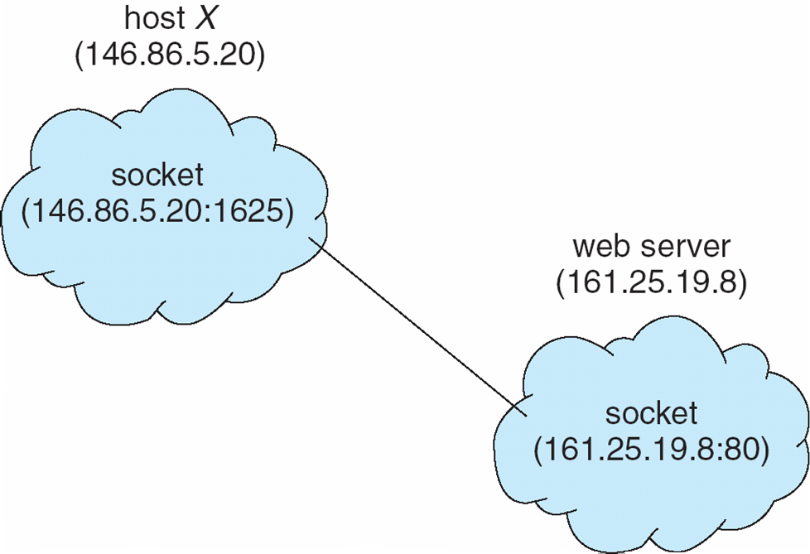
Socket Communication

